Slide 1

Problem Solving
Jeslyn Ho Ka Yan

Slide 2
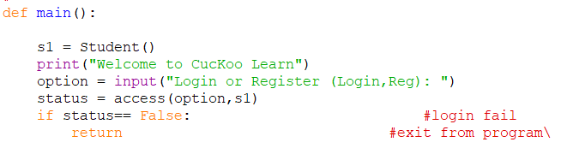
Introduction
I designed a mini program to automate simple arithmetic quizzes for primary 1 students
Once the student had started running the program,
- They will be given an option (login/reg)

Slide 3
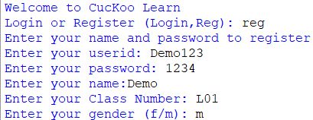
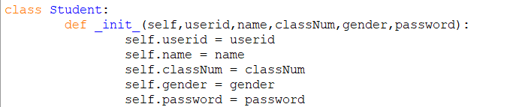
Registration
New users are required to create an account
They need to input their own use rid, password, name, class number, and gender.

Slide 4
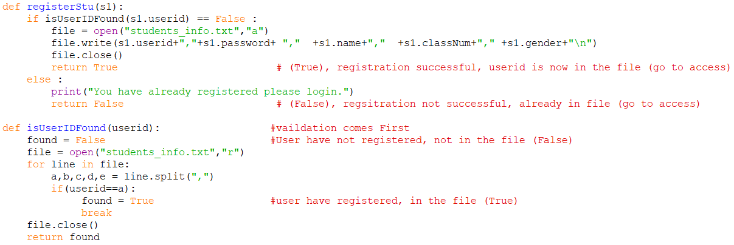
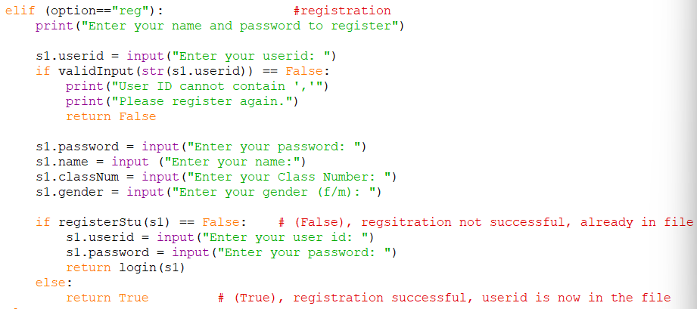
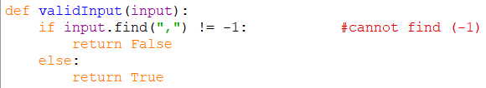
Registration

Slide 5
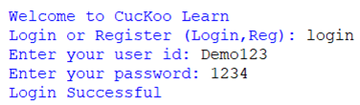
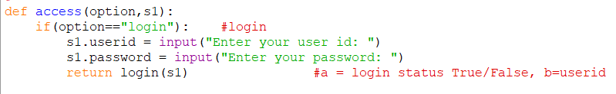
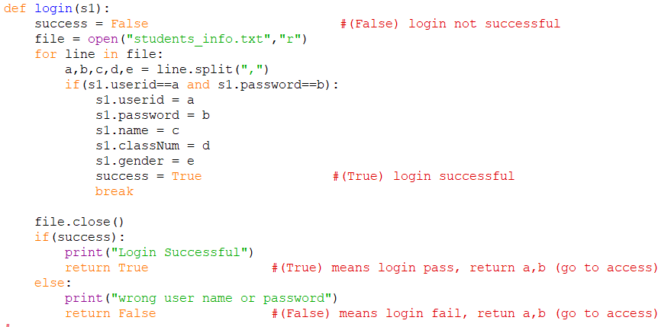
login
Users are required to enter their own user id and password

Slide 6
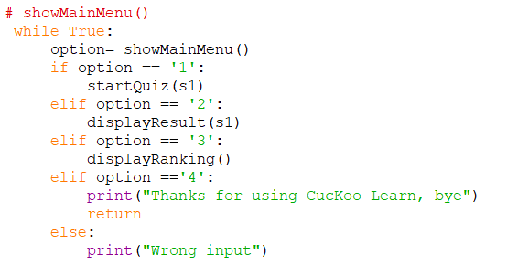
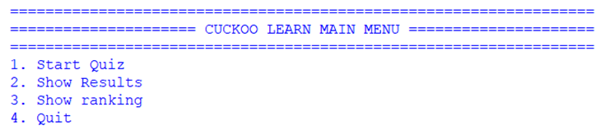
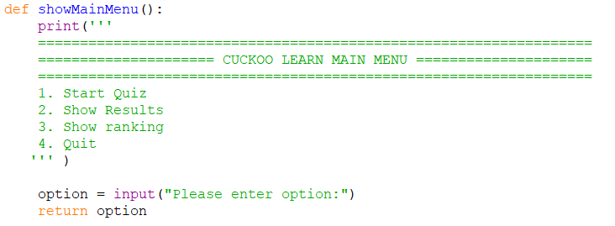
Menu
A menu will be displayed.
Users will have 4 options to choose from.

Slide 7
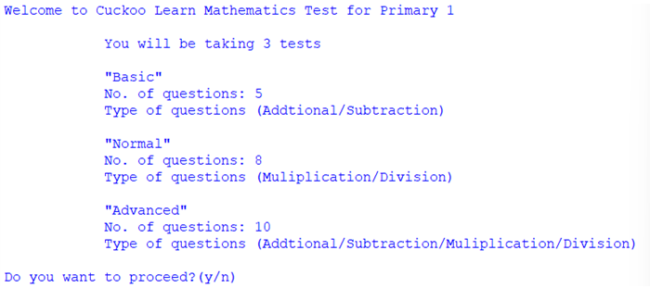
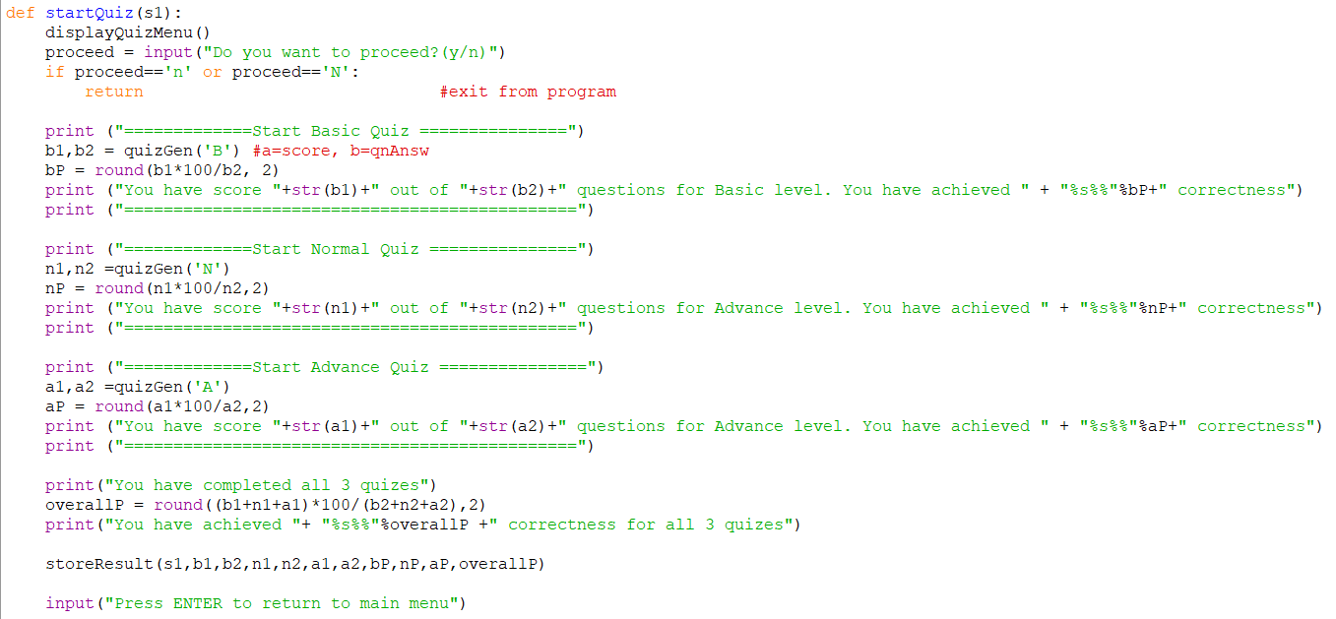
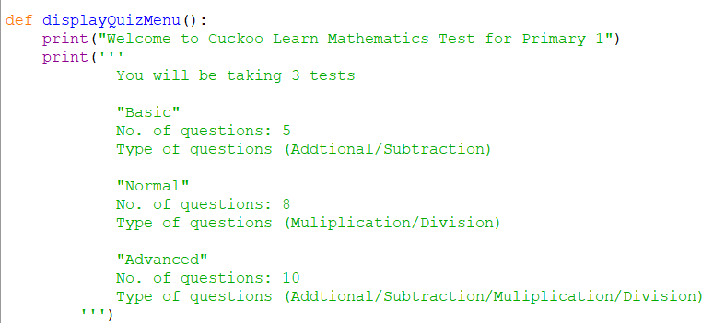
Start Quiz
A quiz menu will then be displayed.
The user has to decide if they want to proceed with the quiz.

Slide 8
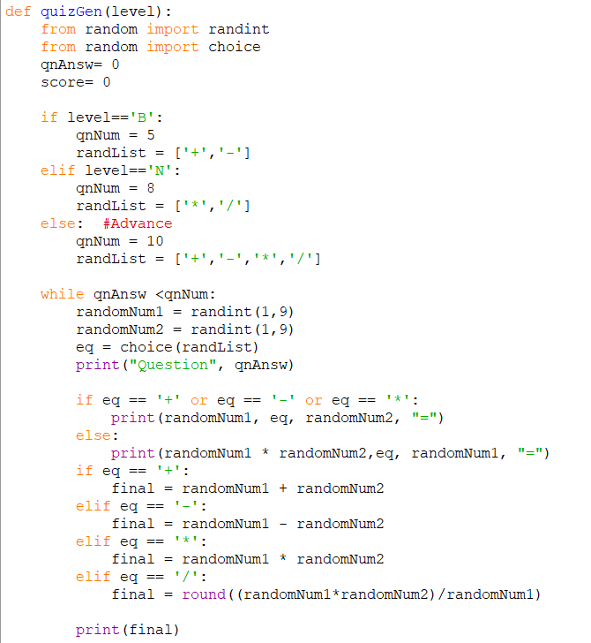
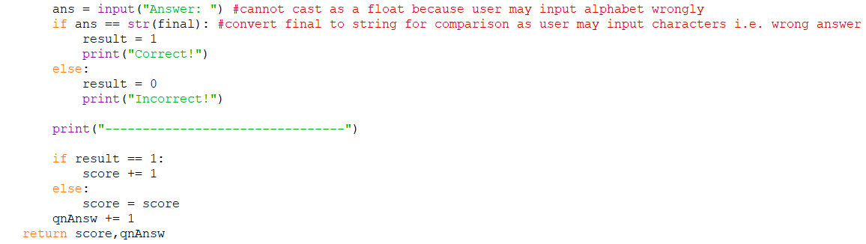
Start Quiz

Slide 9
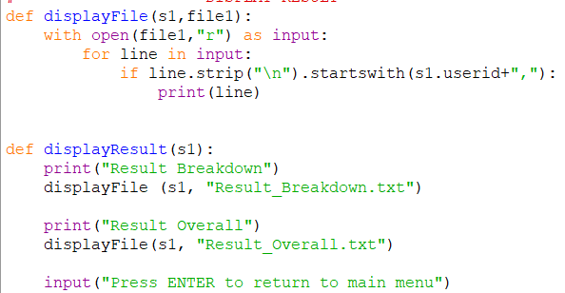
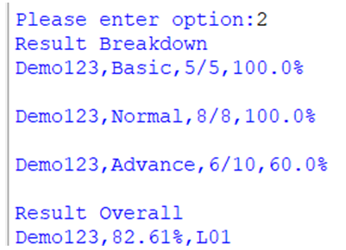
Show Result
The 3 different types of quiz results will be displayed respectively. It will state the number of correct questions the user has answered and the percentage of correct answers for each question. The student is allowed to take multiple trials of quizzes of the same type but only the last trial result of each quiz will be stored and ranked.

Slide 10
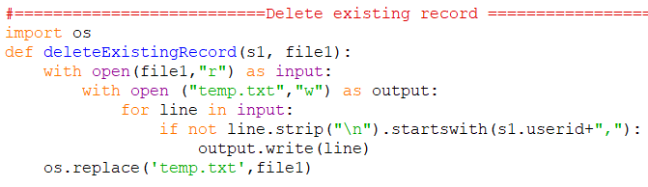
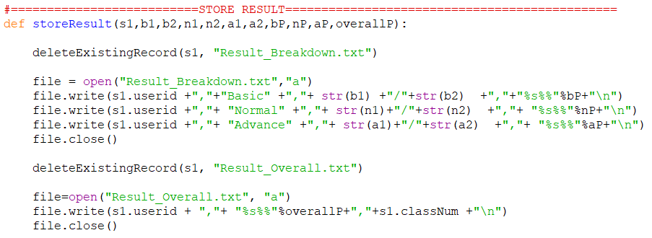
Show Result

Slide 11
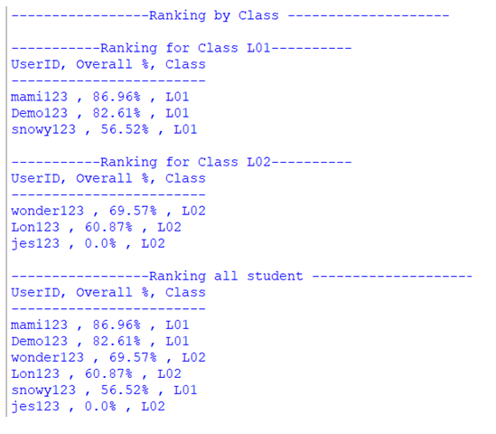
Show Ranking
There will be 2 types of ranking. Class ranking and overall ranking
Students can see all the class rankings and overall rankings.

Slide 12
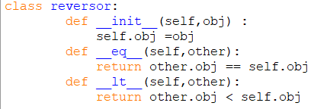
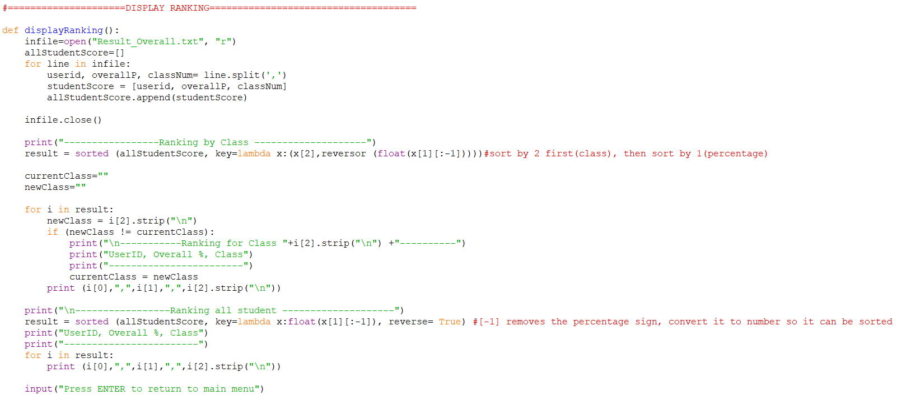
Show ranking

Slide 13
THANK YOU
Bye.

